Slide 1
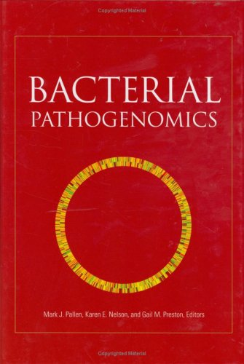
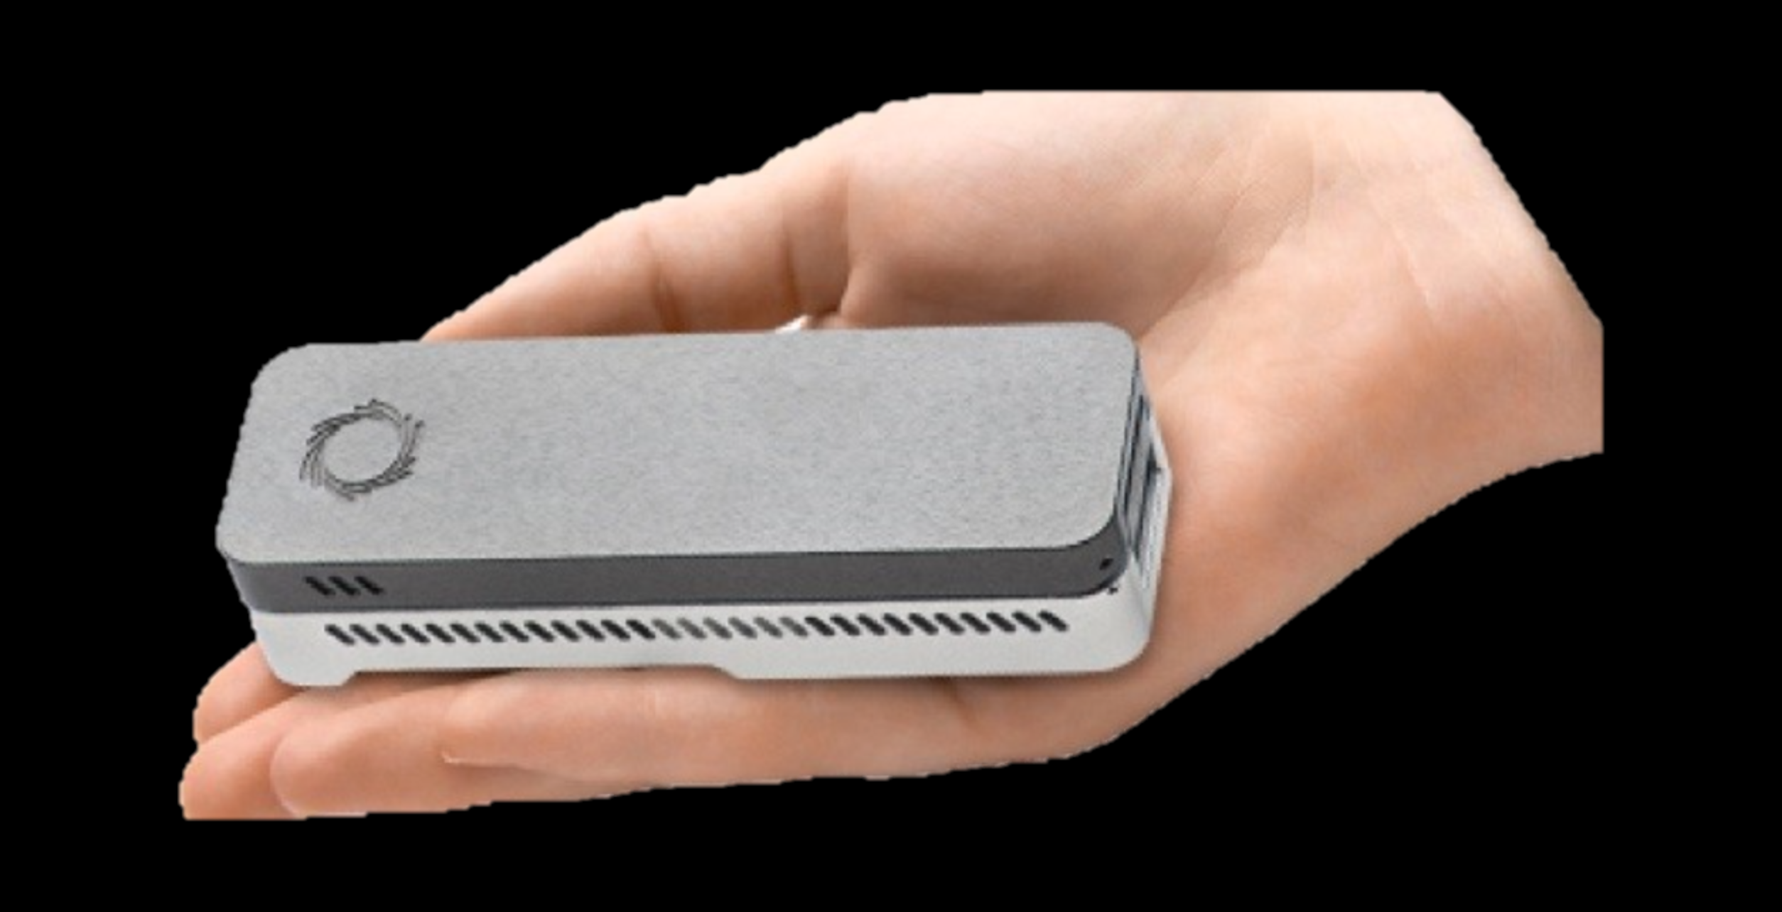
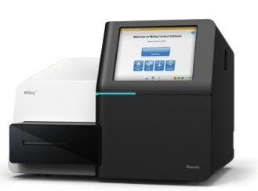
Microbial Genomics Theory and Practice
Professor Mark Pallen

Slide 2
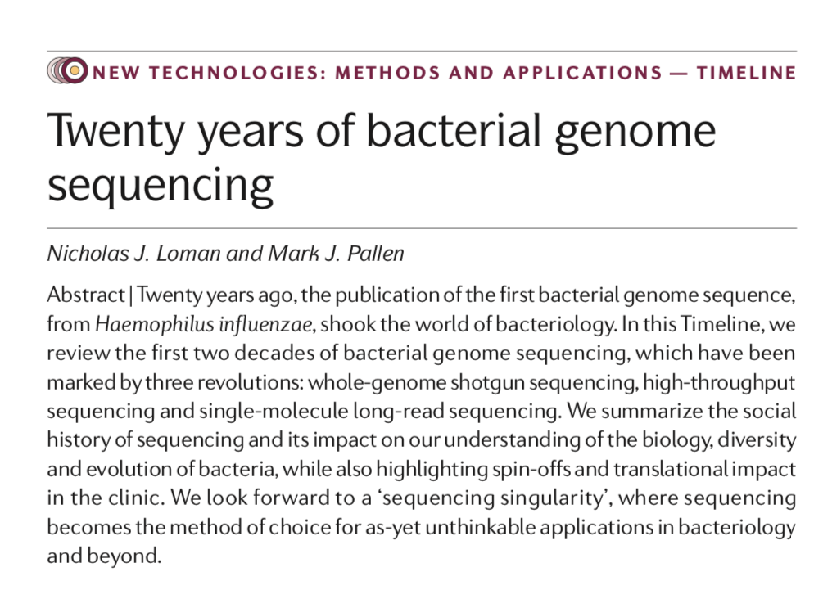
A few questions…
How big is a bacterial genome?
How do bacterial genomes differ from the human genome sequence?
What can you learn from a bacterial genome sequence?
Loman and Pallen (2015)
https://www.nature.com/articles/nrmicro3565

Slide 3
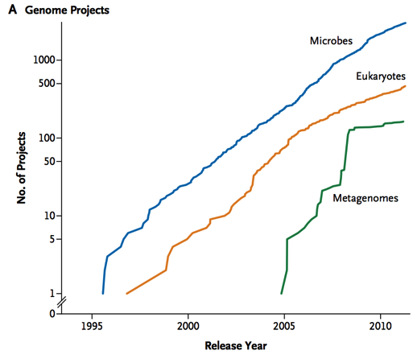
Bacterial Genomics The Golden Era: 1995-2007
Phase 1
Genome sequences from all significant bacterial pathogens of humans, animals and plants
Insights into pathogen biology
Phase 2
Multiple genomes from same species
Insights into genomic diversity

Slide 4
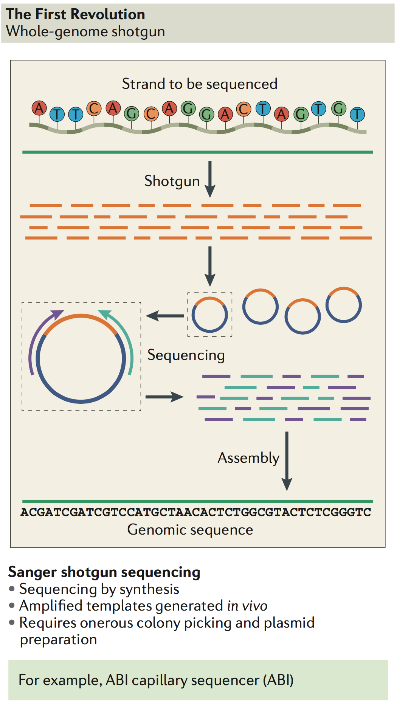
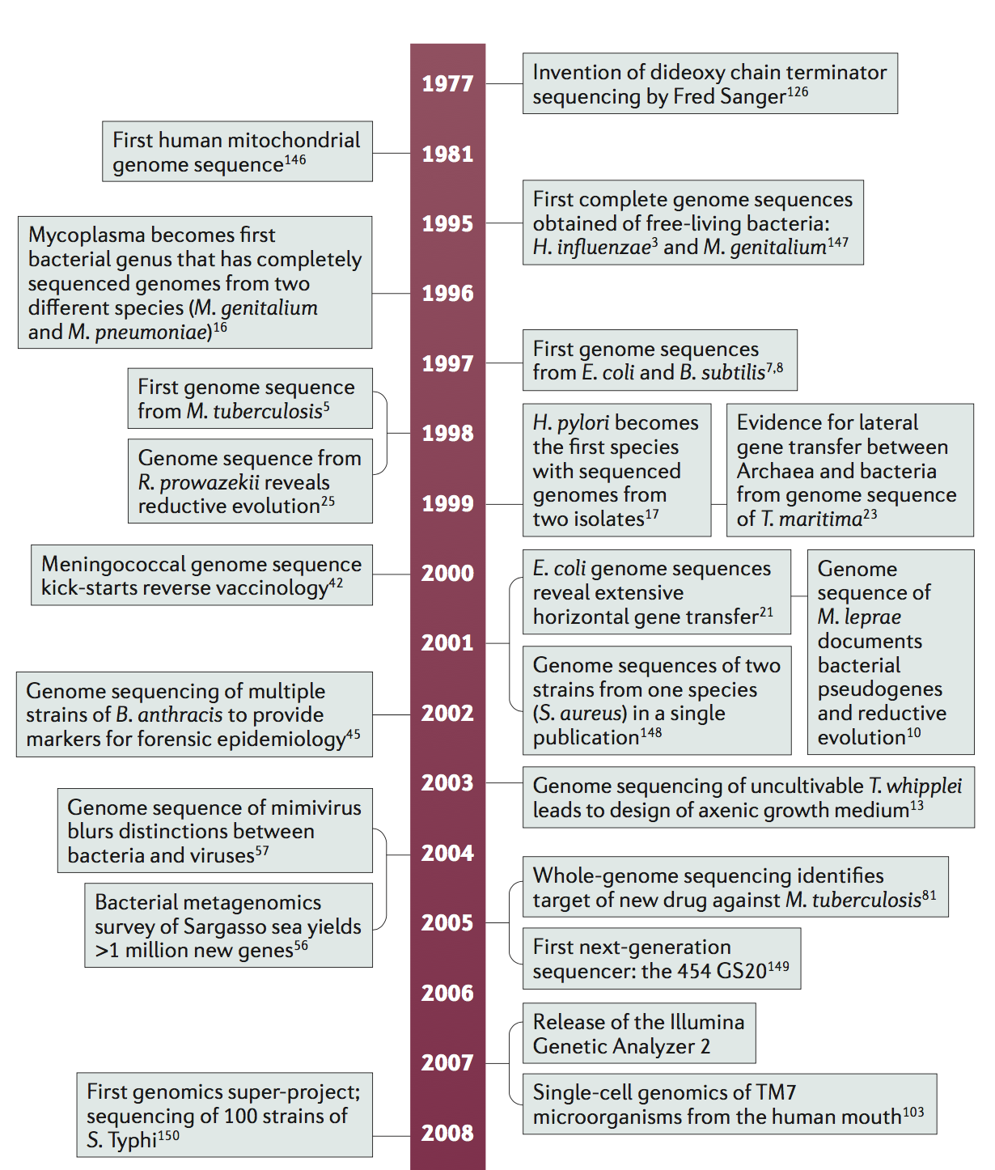
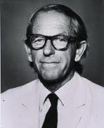


Slide 5
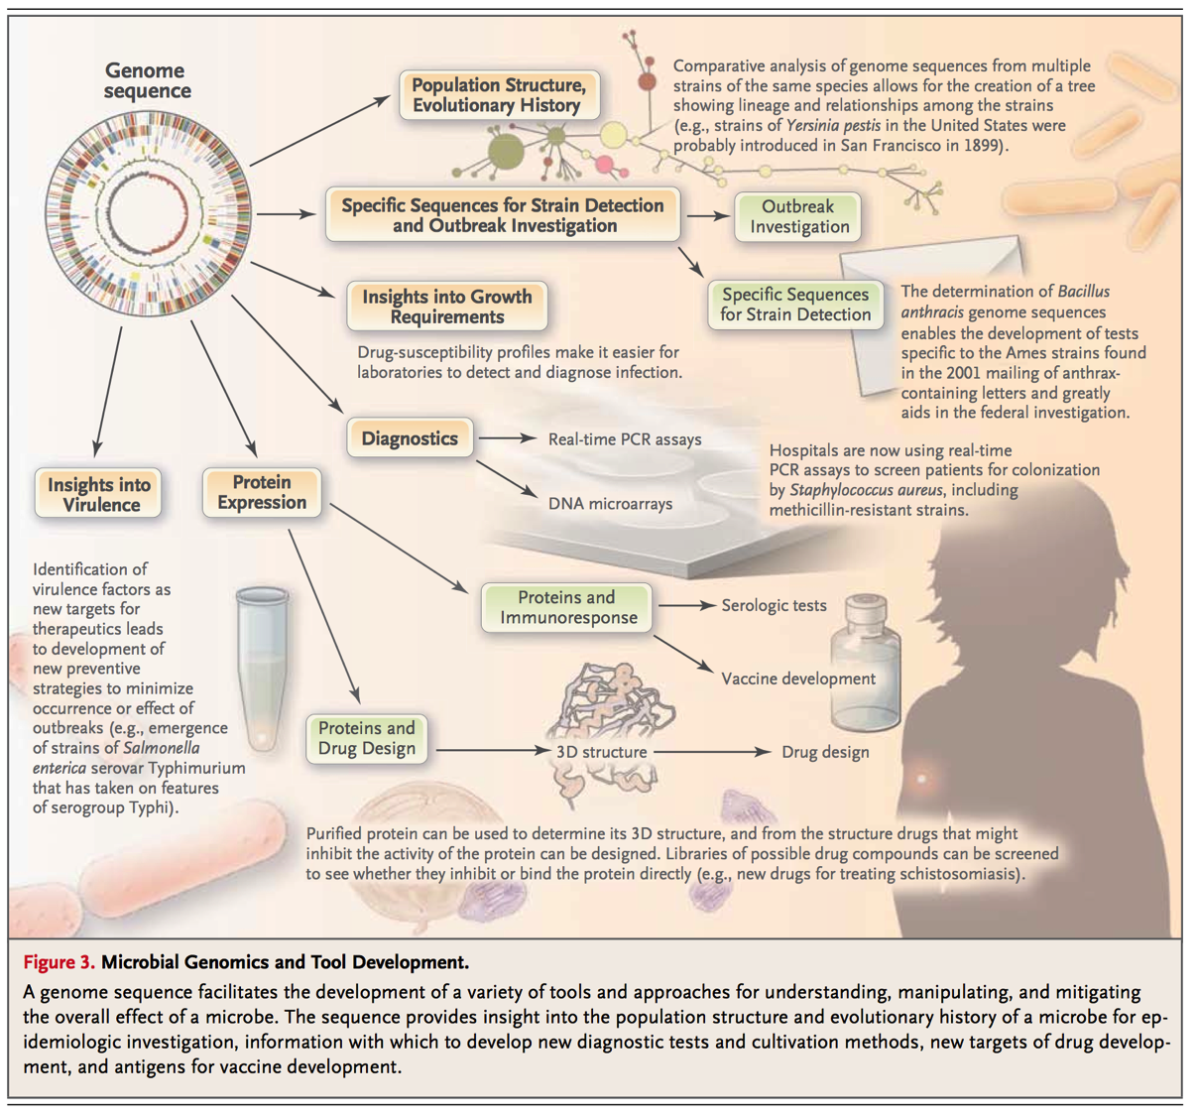
https://www.nejm.org/doi/full/10.1056/nejmra1003071

Slide 6
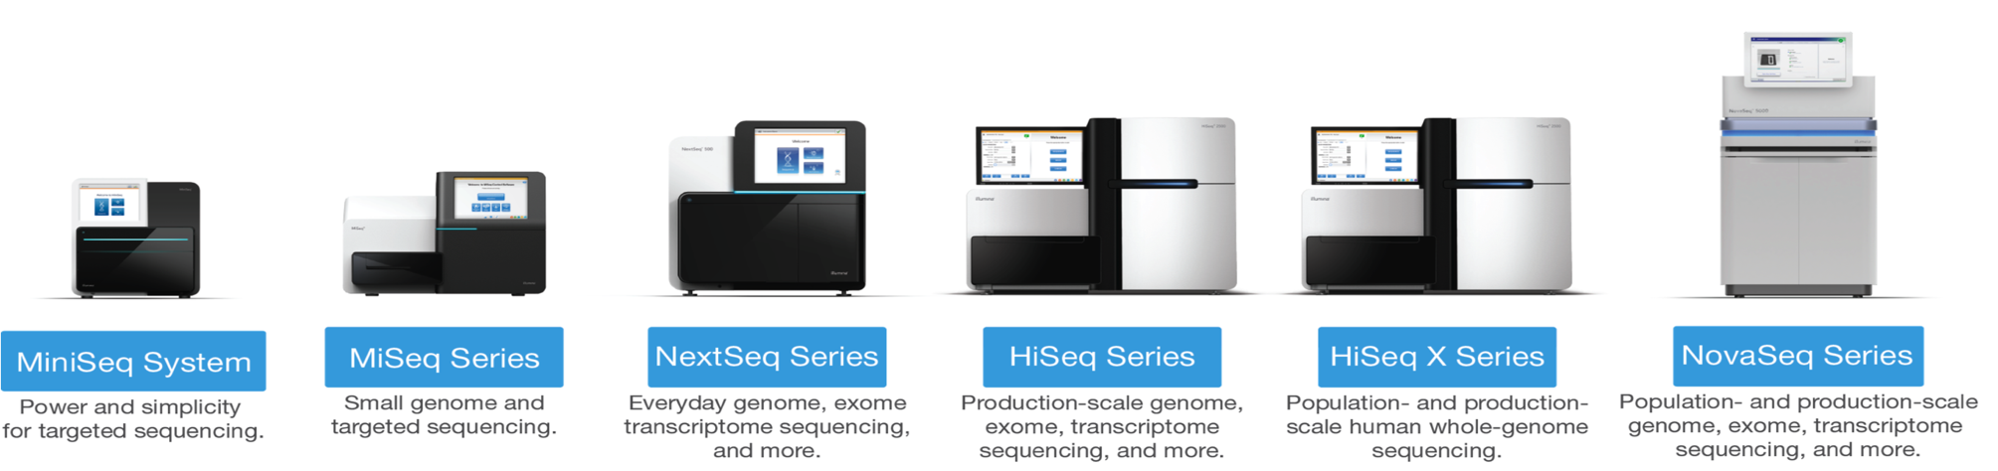
High-throughput Sequencing from 2007 onwards
>1000x faster, >1000x cheaper!
A disruptive technology
Bench-top sequencing easy, quick and cheap enough to have an impact on real-world clinical problems
Illumina short read sequencing

Slide 7
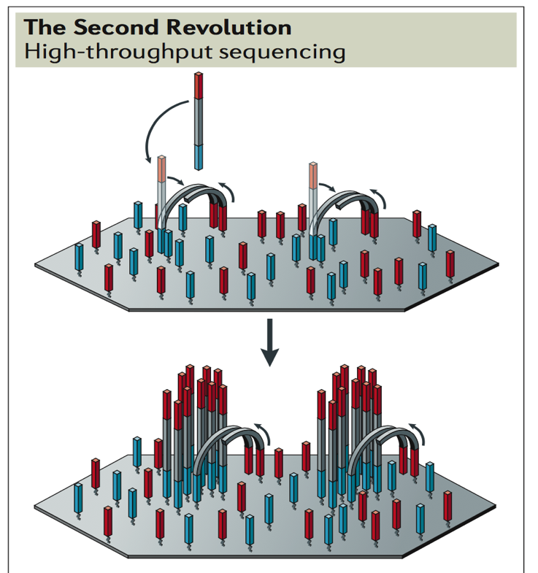
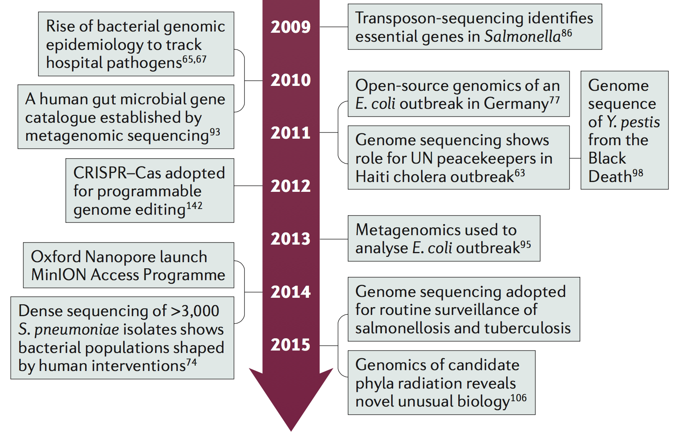
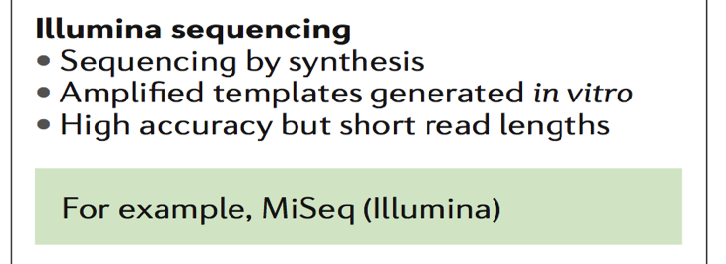
Fundamentally new approaches
Solid-phase amplification of clonal templates in “molecular colonies”
Massive increase in number of “clones” compensates for shorter read length

Slide 8
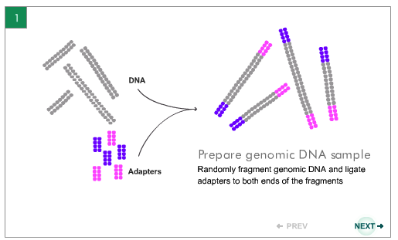
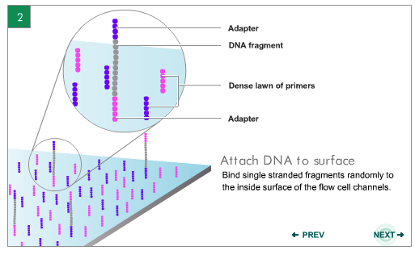
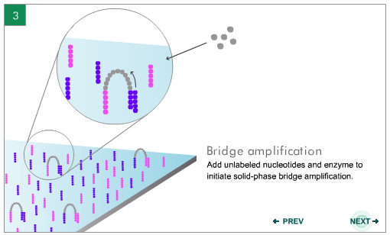
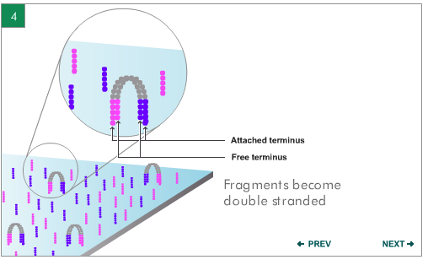
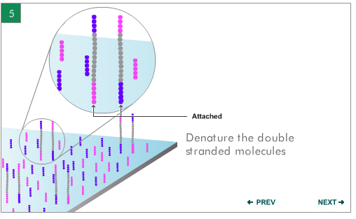
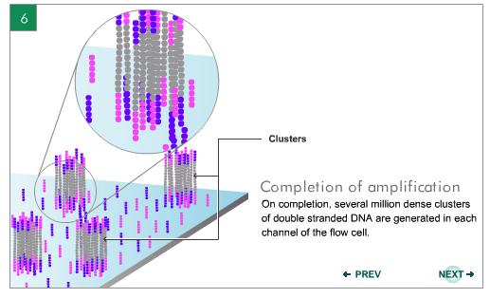
Illumina Sequencing

Slide 9
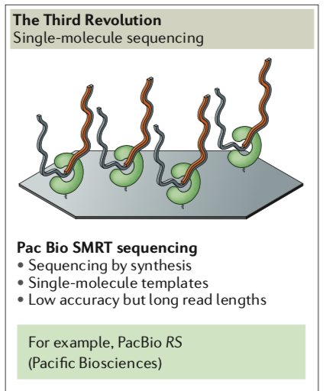
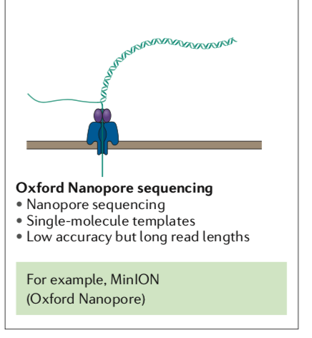

Slide 10
General features of genomes
Microbial
Human
Small WSIWYG genomes (Mbp)
Gene density high (>90%)
intergenic regions short
very little repetitive or non-coding DNA
Introns very rare
Protein-coding genes (CDS) short (~1kbp)
Operons with promoters just upstream
Fewer non-coding RNAs
Very large genomes (Gbp)
Gene density low
Only 25% is genes
Introns mean only1% codes
Genes can span ≥30 kbp
Genes have ~3 transcripts
Splicing and splice variants
Promoter regions distant from gene

Slide 11
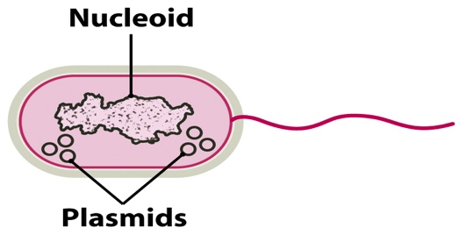
Bacterial genome organisation
Chromosomes
Plasmids
Most commonly single circular chromosome (always DNA)
BUT many species have linear chromosome(s) (e.g. Borrelia, Streptomyces, Rhodoccus)
BUT a few species with two chromosomes (e.g. Vibrio cholerae)
Can be mix of circular and linear (e.g. Agrobacterium tumefaciens, B. burgdoferi)
Independent autonomous replicon, can be circular or linear
may integrate into chromosome
copy number varies 1 to 10s
often carry non-essential genes that confer an adaptive advantage in certain conditions

Slide 12
High-Throughput Shotgun Sequencing
Random shearing
bacterial
chromosome
Size selection
Sequence
Amplify
Add adapters

Slide 13
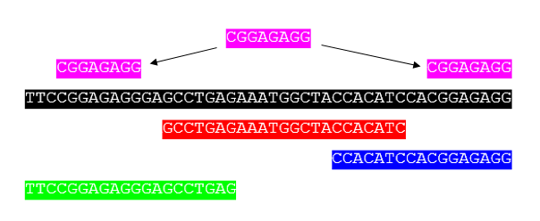
Sequence assembly

Slide 14
Genome Assembly
Contig 1
Contig 2
Contig 3
Sequence Gap
Scaffold
Physical Gap

Slide 15
Genome annotation
Annotation is the addition of information about the predicted sequence features to the flat file of DNA code
Identification of potential coding sequences - CDS
Homology searches to predict function
Other features can be annotated as well
rRNAs
Potential promoters
tRNAs
Small non-coding RNAs
Repeat sequences
Insertion sequences (ISs), transposons, gene fragments
Location of the origin of replication
Determination of the number of bases, genes, and G+C%.

Slide 16
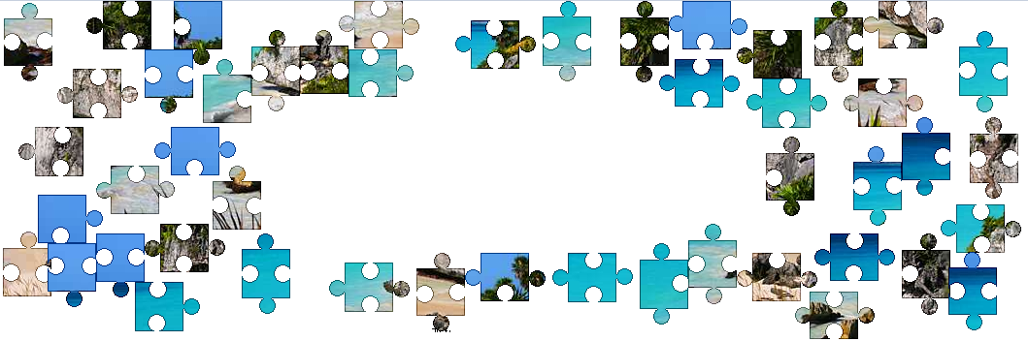

Mapping
Short reads (<200bp) often inefficient de novo assembly
Instead they are mapped against a reference genome
Like assembling a jigsaw puzzle using the image on the lid

Slide 17
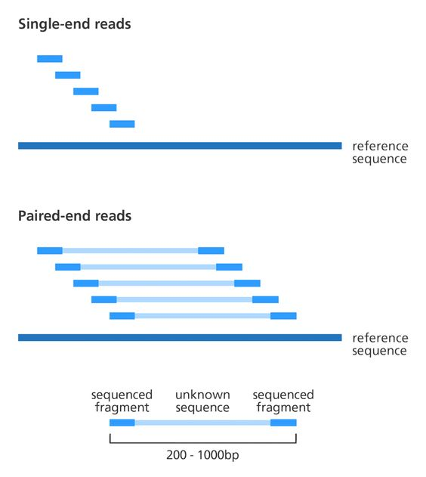

Slide 18
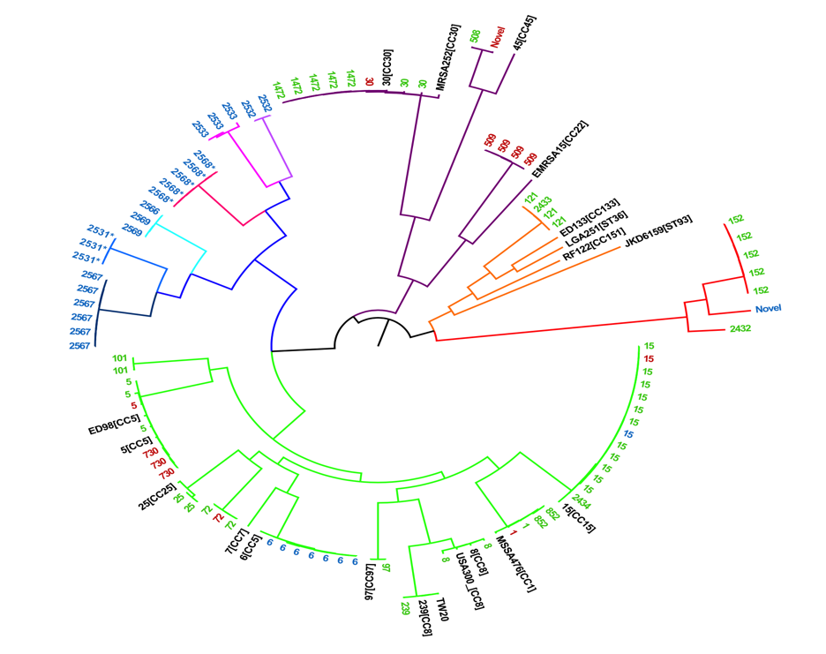
SNP calling
Comparisons between closely related strains allows identification of SNPs that are informative for
Identifying biologically significant changes, e.g. during evolution in lab or patient
Reconstructing phylogenies using neutral changes
ATGTCGAGTGACCAGTGAGTAG
ATGTCGAGTCACCAGTGAGTAG

Slide 19
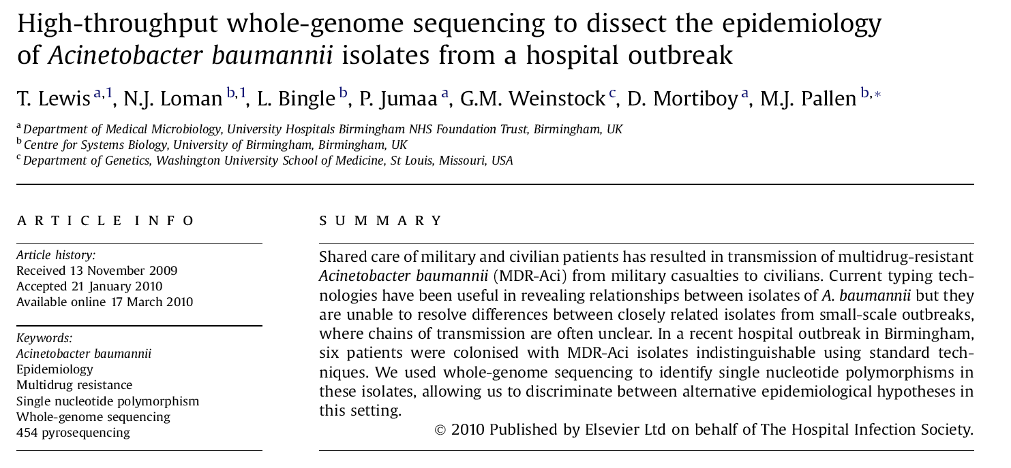
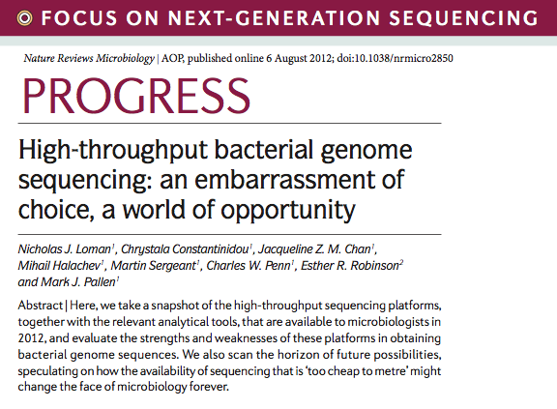
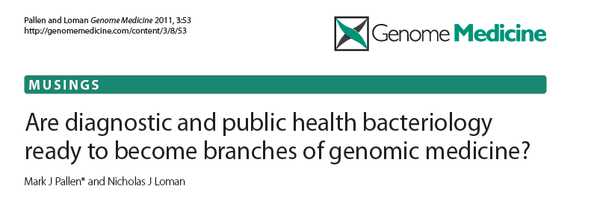
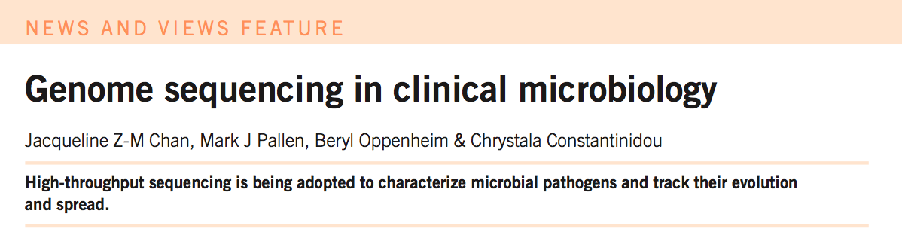
Genomic Epidemiology

